Slide 1
St James PE Department 4 week challenge!
Aim: To complete a 4 week training programme to develop your individual fitness level. Including pre and post training test to monitor if you have achieved your goal - improved your fitness!

Slide 2
Per training test – 12 Minute Cooper Run.
Why test before starting a training programme?
Fitness testing is a essential feature of all fitness training and should be completed before training begins, during the training programme and again at the end of the training programme.
The importance of fitness testing

Slide 3
12 Minute Cooper Run
The Cooper run is the total distance run round a marked area in 12 minutes. You then compare your results with the official results tables and identify how fit you are for your age group.
Watch this video about the cooper run.

Slide 4
Results tables:
The tables for the Cooper test are arranged by age and gender.
In addition to seeing how you compare to these norms, you can document the progress you make as you become fitter over time.

Slide 5
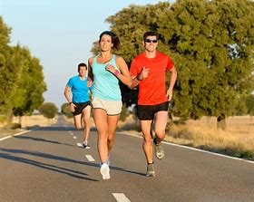
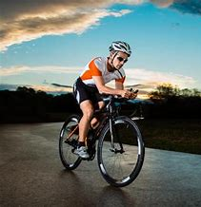
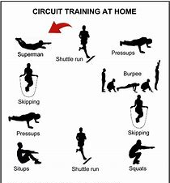
Training Methods
There are a number of different methods of training that can improve health and fitness e.g. Continuous training, Fartlek (speed play) training, Interval training, Weight training and Circuit training. We will be having a look at some of these over the 4 weeks.
Warming up and cooling down are essential parts of a training session.

Slide 6
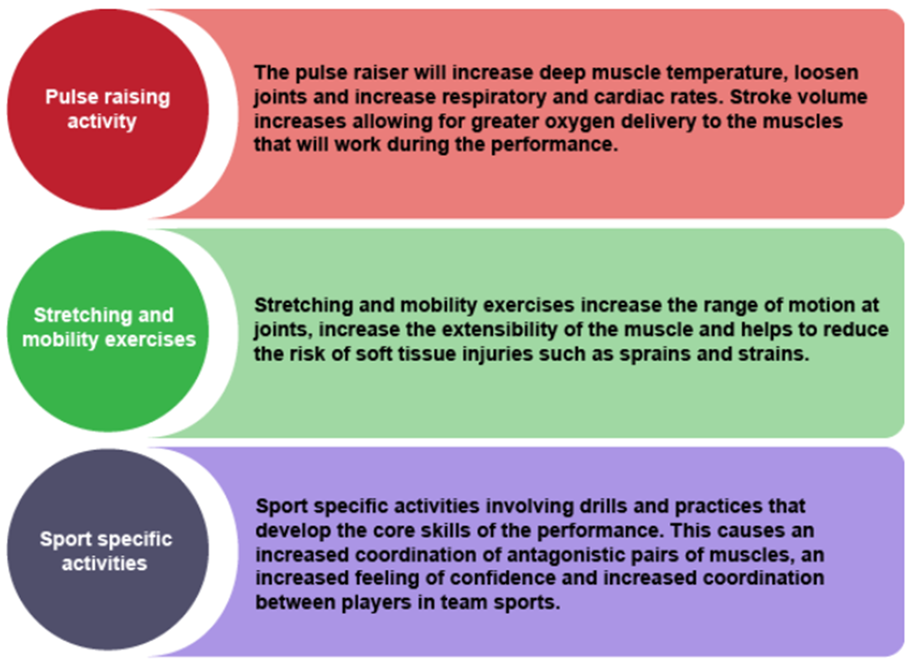
The effects of the warm up and cool down.
Every session starts with a warm up and ends with a cool down.
Warm up
The diagram opposite shows the three primary components of an effective warm up. All warm ups should last 5 -10 minutes.

Slide 7
Cool down
The diagram opposite shows the three primary components of an effective cool down.
Athletes must always cool down after training.

Slide 8
Methods of training. The method of training used needs to be specific to the individual performer if they want to see changes in their fitness levels and enjoy it!
Week one: Continuous training.
Continuous training develops cardiovascular fitness
A minimum of 20 minutes sub-maximal work.
Target heart rate range is between 60% - 80% maximum heart rate (maxHR).
Continuous training can be: swimming, running, cycling, walking or a combination of these.
Disadvantage - some participants find longer sessions to be boring, that’s why it is very important to find something you enjoy to have success!

Slide 9
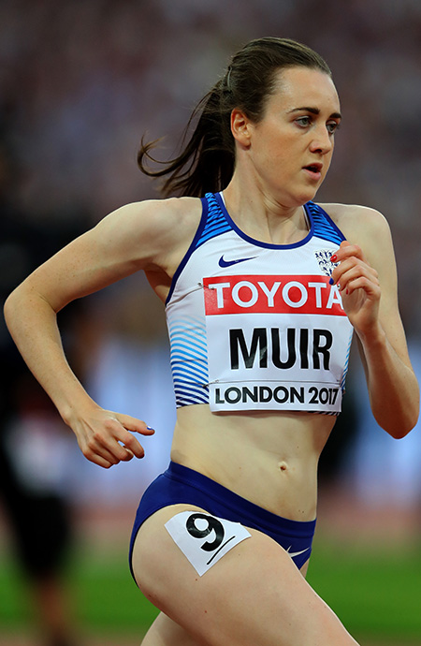
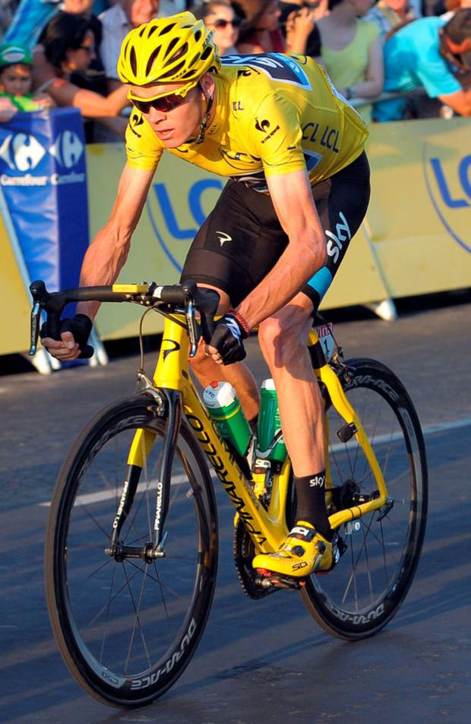
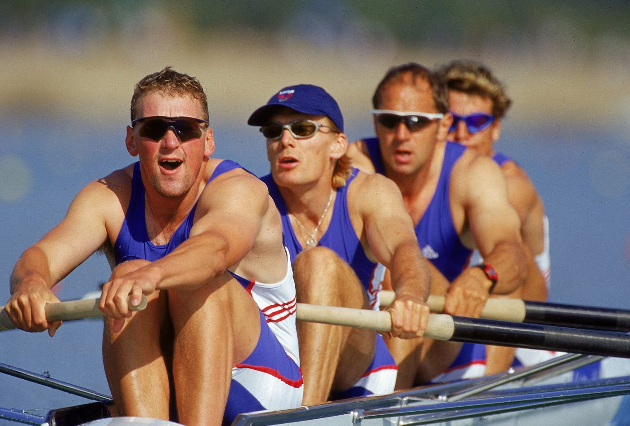
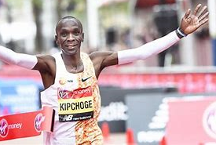
Continuous training involves comparatively moderate exercise performed for a relatively long period.
For example: Cycling at a average speed for 30 minutes is one example of continuous training.
It helps you to develop your aerobic fitness and muscular endurance.
Top athletes such as Chris Froome and Eliud Kipchoge and Laura Muir often use continuous t training to help raise their heart rates to the I right level. Matthew Pinsent was up at 5am d doing continuous training every morning whe training for the Olympics.

Slide 10
Now for the hard work!!
Task one: Complete your Pre training test – 12 Minute Cooper run.
1. Complete a warm up - Look back at the slide on warm up if you need to remember what to include.
2. Carry out your Cooper Run –
Year 6 and 7 - 9 minutes instead of 12 minutes.
Challenge – if you want to challenge yourself and have a go at 12 minutes go for it!
Year 8 and 9 – complete the full 12 minute Cooper Run.
Remember to time and measure your distance!
3. Cool down - Look back at the slide on cool down if you need to remember what to include.
4. Record your results as you will need them in 4 weeks time, to review how successful your training has been. You can submit your results on SMHW.
Mrs Floyd’s Cooper Run results, see if you can beat her!
(1.60 miles = 2575 metres)

Slide 11
Task two: Continuous training.
Over the next week you need to carry out three Continuous training sessions. These could be running, cycling, walking or scooting.
Each session needs to last between 20 - 30 minutes and you should feel like you are working hard (your heart rate should increase and you should be out of breath). Depending on your current fitness level think about how long you want your session to last e.g. if you are just starting go for 20 minutes.
Make sure you complete a warm up and cool down for each session to prevent injuries.
Record your results so you can monitor how you are getting on e.g. day, how long the session lasted, distance covered. Something like the Strava app will do all this for you, just remember to press start!
Remember safety at all times! Always tell somebody where you are going and it is always sensible to take a phone with you.

Slide 12
Good luck and happy training! Remember you can email or tweet your result to the PE department @StJamesPEDept to show the department how your getting on, especially your 9 minute or 12 minute cooper run results!

