Slide 1
Starts 22nd January
St James’ Inter-Form Family Fitness Challenge

Slide 2
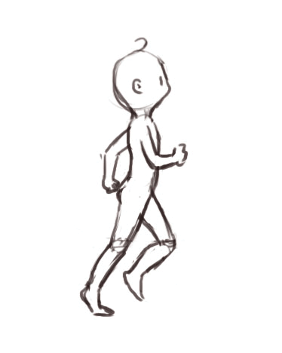
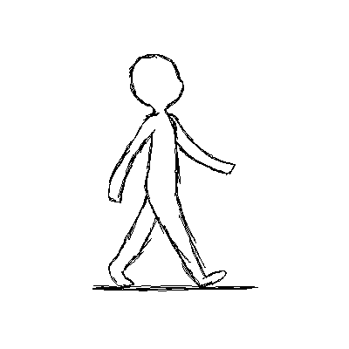
HOW FAR CAN YOU RUN/WALK?
Jogging and walking are both excellent types of exercise. Both burn fat, improve your stamina and make your heart stronger.
Exercising outdoors is also excellent for your mental health, as it relieves stress, especially important in present times.

Slide 3
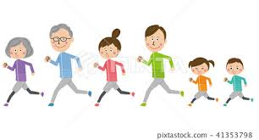
EXERCISING AS A FAMILY
Exercising together, as a family, strengthens family bonds and improves the overall mood of both children and parents.

Slide 4
COMPETITION
Competition makes exercise more fun, and gives you a challenge to meet and common goal to aim for.

Slide 5
SO, THE FAMILY FITNESS CHALLENGE!
How far can you, and your family jog or walk? The form that covers the most distance in a week will be the winners!
The competition will run on a weekly basis- starting on a Friday morning each week, with results announced the following Friday, when the next round will begin.

Slide 6
HOW THE COMPETITION WILL RUN (or WALK!)
If you walk for 5 miles on your own, you will add 5 miles to your form’s weekly total- But, if you walk 5 miles with three other members of your family, that will count as 20 miles! (Canines not included-sorry!)
The exercise can take at anytime during the week-Either at weekends, lunchtimes, after 3pm or when you would normally be having your PE lesson in school. (We will continue to offer other fitness activities for those who prefer to exercise indoors)

Slide 7
INTER-FORM FAMILY FITNESS CHALLENGE
So, let your PE teacher know how far you and your family have jogged/walked each time you get out and do some exercise. Aim for at least 10 minutes jogging or 20 minutes walking in each session- although I am sure you can do more!

Slide 8
WHO WILL WIN?
The PE staff will calculate how far each form has travelled each week. Can 7A reach Liverpool? (36 miles) Will 8C get to Leeds? (44 miles) or can 9M travel as far as Birmingham? (71 miles).
Send all your results (and photo’s- lots of them!) via SMHW to Mr Walker (all boys in Year 7,8 and 9) or Miss Floyd and Miss Hewson (Year 7, 8 and 9 girls) as soon as you get home.
i.walker@stjamescheadle.co.uk
b.hewson@stjamescheadle.co.uk
v.floyd@stjamescheadle.co.uk

Slide 9
FAMILY FITNESS CHALLENGE
Let’s Go! – The St James’ Inter-Form Family Fitness Challenge begins this Friday!
Follow @StJamesPEDept on Twitter for updates on the competition.

