Slide 1
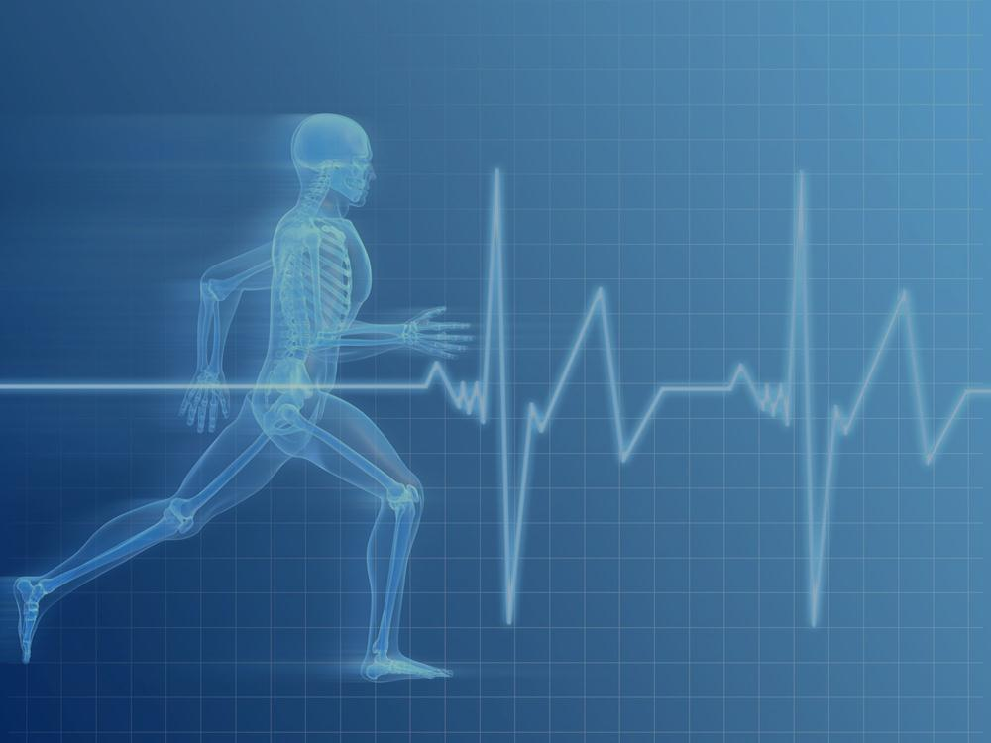
Year 7,8,9 Circuit
22.06.20

Slide 2
What you need
Timer
2 bottles of water / weights
Mat/ blanket/towel – something soft to lie on when doing the exercises.

Slide 3
All pupils should participate in the circuit.
All pupils do the same warm up.
Low intensity – 35 seconds work, 25 seconds rest
Moderate intensity – 40 seconds work, 20 seconds rest
High intensity – 45 seconds work, 15 seconds rest.
Choose your preferred version of each exercise.
Do a minimum of two rounds, three would be great!
Increase the intensity or choose the harder version of the exercise on the second/third round.

Slide 4
Warm up Do the warm up in time with Miss Hewson
30 seconds – Jogging
30 seconds – Star jumps
30 seconds – Jogging
30 seconds – High knees
30 seconds – Jogging
30 seconds – Heel flicks
20 seconds – Jogging
10 seconds – Sprinting
20 seconds – Jogging
10 seconds – Sprinting

Slide 5
Exercise 1 – Sit ups
Hard = Hands on side of head
Middle = Hands across chest
Easy = Hands on legs

Slide 6
Exercise 2 – Press ups
Hard = Full Press up
Easy = Half press up, on knees.

Slide 7
Exercise 3 - Squats
Easy = Squats
Hard = Jumping squats

Slide 8
Exercise 4 – Burpees
Easy = Burpee
Medium = Burpee, high jump
Hard = Chest to floor burpee

Slide 9
Exercise 5 - Crunches
Easy = Crunches with arms supporting
Hard = Arms across chest

Slide 10
Exercise 6 – Bicep Curls
Use weights or water bottles

Slide 11
Exercise 7 – Lunges
Easy = Lunges
2. Hard = Jumping lunges

Slide 12
Exercise 8 – Star jumps
Easy = Star jumps
Hard = Star jump, tuck and touch the floor

Slide 13
Exercise 9 – Russian twists
Easy = Feet on floor
Medium = Feet raised
Hard = weight in hands

Slide 14
Exercise 10 - Punches
Easy = static punches
Hard = Punch and twist

Slide 15
Exercise 11 – Tuck jumps
Easy = Jump, rest, jump
Hard = continuous jumping

Slide 16
Exercise 12 – Criss cross squat
Easy – Criss cross squat
Hard - Criss cross, squat and touch the ground

Slide 17
Repeat the whole circuit 2/3 times

Slide 18
Cool Down
Hold each stretch for 8-10 seconds
Try to name each muscle you are stretching

Slide 19
Circuits/ workouts you can do yourself
Who | What | Where | When
Courtney Black | Fitness | Instagram | Live workouts every day (8am)
Solo Sessions | Netball | Instagram | Live workouts week days (10am)
James Harvey | Fitness | Youtube | Daily workouts posted
Joe Wicks | Fitness | Youtube | Workouts everyday (9am)
Megan Grubb | Fitness | Instagram | Live workout (9am)
Oti Mabuse | Dance | Youtube / Facebook | Regular videos posted, (11am, 7pm)
Pure Gym | Fitness | Instagram | Daily workouts, variety of timings
7mlc | Football | Youtube | Regular videos posted
Mark Wright | Fitness | Instagram | Videos save to IGTV
Or try and create your own!

